Slide 2
Objectives
Understand the purpose of storing data in a file to be used by a program
Open, close and use a file for reading and writing including:
Read and write single items of data
Read and write a line of text

Slide 3

Starter
Programs make use of variables and arrays such as:
Results ← [52, 87, 69, 83, 95] CurrentResult ← Results[1]
If we are able store data in RAM with variables and arrays, why do we need to store data in files?

Slide 4
Starter
Why do we need to store data in files?
RAM is primary storage and volatile (temporary)
Files are stored in secondary storage which is non-volatile (permanent)
Files may be shared with other computers or users
If stored on shared storage, files may be accessed by multiple users

Slide 5
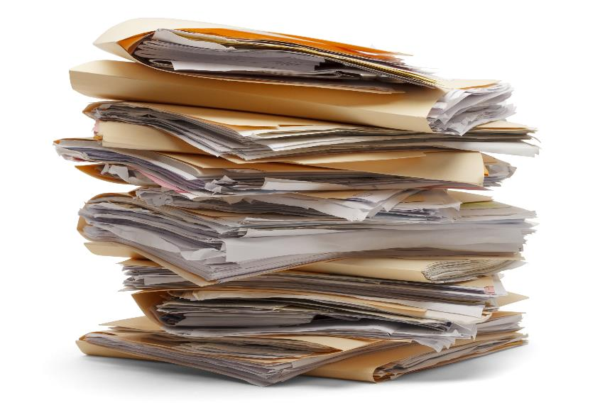
Reading and writing to files
In a programming language, when we read from, or write to a file what three steps always need to be taken?

Slide 6


Reading and writing to files
Reading from and writing to files requires the following steps:
Open the file
Read from, or write to, the file
Close the file
If the file doesn’t yet exist it will need to be created first

Slide 7
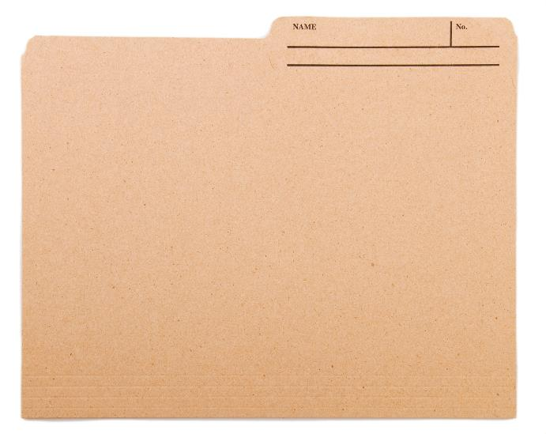
Creating a file
To create a new file use the code:
OPENFILE FileA.txt FOR WRITE
A file needs to be opened before it can be written to
FileA.txt can now be written to in the rest of the program
When creating the file (in IGCSE pseudocode) opening the file in WRITE mode will create a new file, losing any original data if the file already existed

Slide 8
Reading from a text file
Reading from a text file involves opening the file, processing each line then closing the file
OPEN marks.txt FOR READ
WHILE NOT EndOfFile DO
READFILE marks.txt, line
OUTPUT line
ENDWHILE
CLOSEFILE marks.txt
Open “marks.txt”
Loop through each line in the file
Read the next line
Output the line
Close “marks.txt”

Slide 9
Worksheet 2
Now complete Task 1 on Worksheet 2

Slide 10
Writing data to a text file
Here is an algorithm which writes to a text file:
OPENFILE marks.txt FOR WRITE INPUT name INPUT mark record ← name + "," + mark + "\n" WRITEFILE marks.txt, record CLOSEFILE marks.txt
If the user’s name is “Sandra” and their mark is 85 the following will be added to the file:
Sandra, 85
\n means create a new line in the file

Slide 11
Closing a file
Once you have finished reading or writing to a file it is important to close it
This frees up any memory used by having it open
Once closed, the file cannot be read from or written to without opening it again
To close a file, use:
CLOSEFILE filename

Slide 12
Worksheet 2
Now complete Task 2 on Worksheet 2

Slide 13


Plenary
With a partner, answer the following questions:
What are the three steps required to read from, or write to, a file?
What are the two modes that files may be opened in?

Slide 14
Plenary
What are the three steps required to read from, or write to, a file?
Open, Read/Write, Close
What are the two modes that files may be opened in?
READ, WRITE

